Slide 1

Medium Access Control Sublayer
12.<number>
Copyright © The McGraw-Hill Companies, Inc. Permission required for reproduction or display.

Slide 2

Figure 12.1 Data link layer divided into two functionality-oriented sublayers
12.<number>

Slide 3

Figure 12.2 Taxonomy of multiple-access protocols discussed in this chapter
12.<number>

Slide 4
12-1 RANDOM ACCESS
In random access or contention methods, no station is superior to another station and none is assigned the control over another. No station permits, or does not permit, another station to send. At each instance, a station that has data to send uses a procedure defined by the protocol to make a decision on whether or not to send.
Topics discussed in this section:
ALOHA
Carrier Sense Multiple Access
Carrier Sense Multiple Access with Collision Detection
Carrier Sense Multiple Access with Collision Avoidance
12.<number>

Slide 5

Figure 12.3 Frames in a pure ALOHA network
12.<number>

Slide 6

Figure 12.4 Procedure for pure ALOHA protocol

Slide 7
The stations on a wireless ALOHA network are a maximum of 600 km apart. If we assume that signals propagate at 3 × 108 m/s, we find Tp=????????. For K = 2, the range of R is {0, 1, 2, 3}. This means that TB = ????????? based on the outcome of the random variable R.
Tp=600km/3*10⁸ m/s = 600*1000 /3*100000000 = 6/3000
= 2ms.
Data given: K=2, Hence R= 2 to the power K. R ranges from - > {0,1,2,3}.
When R=0-> Tb=R*Tp=2*0=0ms
When R=1-> Tb=R*Tp=2*1=2ms
When R=2-> Tb=R*Tp=2*2=4ms
When R=3-> Tb=R*Tp=2*3=6ms

Slide 8

Figure 12.6 Frames in a slotted ALOHA network

Slide 9
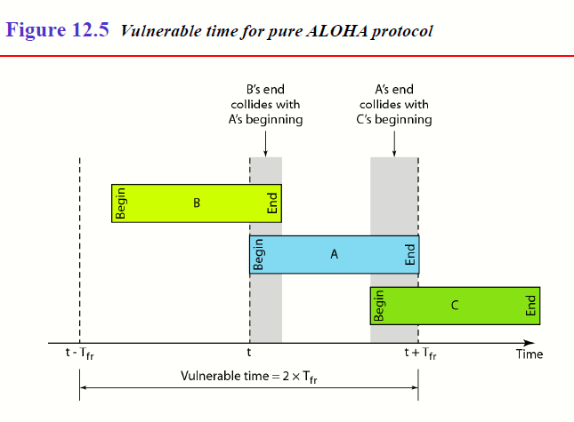

Slide 10

Figure 12.7 Vulnerable time for slotted ALOHA protocol

Slide 11
Throughput for Pure and Slotted ALOHA: average no. of frames successfully transmitted.
‘G’ is the average number of frames generated by the system during one frame transmission time.
The average number of successfully transmitted frames for Pure ALOHA is S = G × e^{-2G} and
Slotted ALOHA is S = G × e^{-G}.
Throughput for Pure ALOHA is S = G × e^{-2G}
Throughput for Slotted ALOHA is S = G × e^{-G}
The maximum throughput Smax for Pure ALOHA is when G=1/2.
Hence, S=0.184
The maximum throughput Smax for Slotted ALOHA is when G=1. Hence, S=0.368

Slide 12
A slotted ALOHA network transmits 200-bit frames on a shared channel of 200 kbps. What is the throughput if the system (all stations together) produces,
a. 1000 frames per second?
b. 500 frames per second?
c. 250 frames per second?
Solution:
Find the Frame transmission time: 200bit-frames/200kbps = 1ms.
Find 1ms how many frames? -> 1 sec – 500 frames G =1
Work out for Pure ALOHA also
12.<number>

Slide 13

Figure 12.9 Vulnerable time in CSMA
12.<number>

Slide 14

Figure 12.10 Behavior of three persistence methods
12.<number>

Slide 15

Figure 12.11 Flow diagram for three persistence methods
12.<number>

Slide 16

Figure 12.12 Collision of the first bit in CSMA/CD
12.<number>

Slide 17

Figure 12.13 Collision and abortion in CSMA/CD
12.<number>

Slide 18
RESTRICTION ON THE FRAME SIZE??
WHY???
  THE FIRST BIT IS TRANSMITTED. IF COLLISION ABORT TRANSMISIION.
  BEFORE LAST BIT OF THE FRAME IS SENT THE COLLISION MUST BE DETECTED. WHY??
    ONCE LAST BIT IS OUT FROM STATION THEN THE STATION DOESNOT HAVE A COPY OF THE FRAME.
    Tfr - > 2*Tp.
12.<number>

Slide 19
Example 12.5
A network using CSMA/CD has a bandwidth of 10 Mbps. If the maximum propagation time (including the delays in the devices and ignoring the time needed to send a jamming signal, as we see later) is 25.6 μs, what is the minimum size of the frame?
Solution
The frame transmission time is T_{fr} = 2 × T_{p} = 51.2 μs. This means, in the worst case, a station needs to transmit for a period of 51.2 μs to detect the collision. The minimum size of the frame is 10 Mbps × 51.2 μs = 512 bits or 64 bytes. This is actually the minimum size of the frame for Standard Ethernet.
12.<number>

Slide 20

Figure 12.14 Flow diagram for the CSMA/CD
12.<number>

Slide 21

Figure 12.15 Energy level during transmission, idleness, or collision
On a wired network, energy level is almost double during a collision.
This is how a receiver tells if there is a collision.
But on a wireless network, energy level is not that high (barely 5-10%
higher). So with wireless, we need to avoid collisions.
12.<number>

Slide 22
CONTROLLED ACCESS METHODS
Reservation –reservation frame – slots- how many? If there are ‘N’ stations then ‘N’ slots.
Polling – one primary station and all other in the network secondary stations.
  Primary has authority to transmit data.
  It Controls the link.
  Select and Poll
Token passing
12.<number>

Slide 23
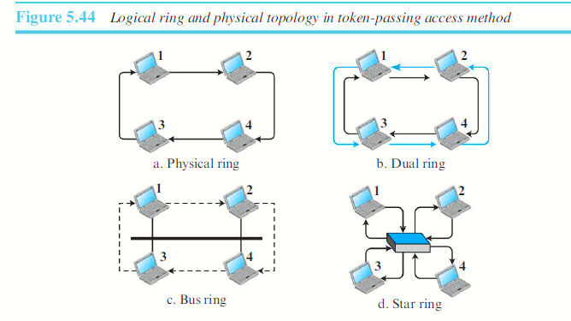
12.<number>

Slide 24
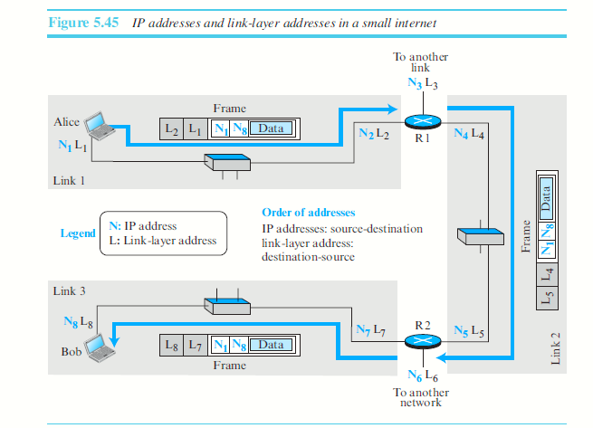
LINK LAYER ADDRESSING
12.<number>

Slide 25
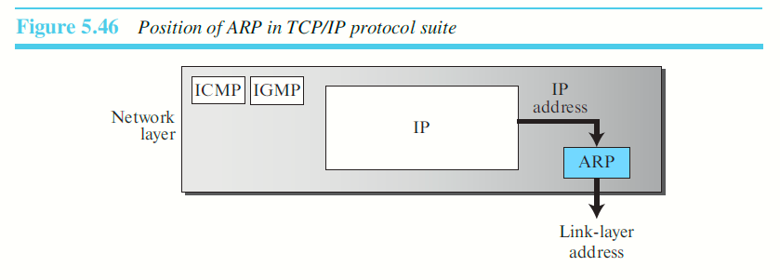
Address Resolution Protocol (ARP)
Maps an IP address to a logical-link address.
12.<number>

Slide 26
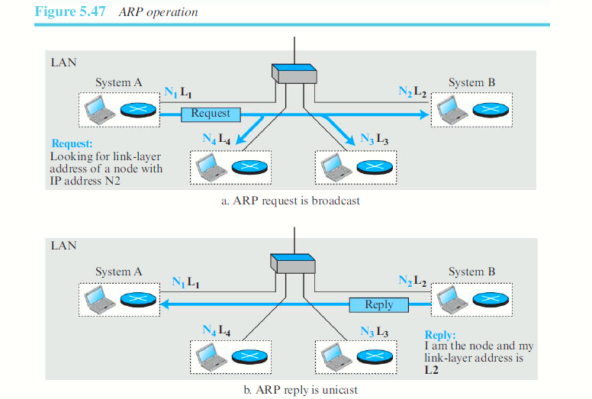
12.<number>

Slide 27
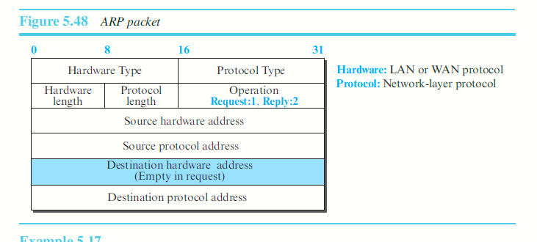
ARP PACKET
12.<number>

Slide 28
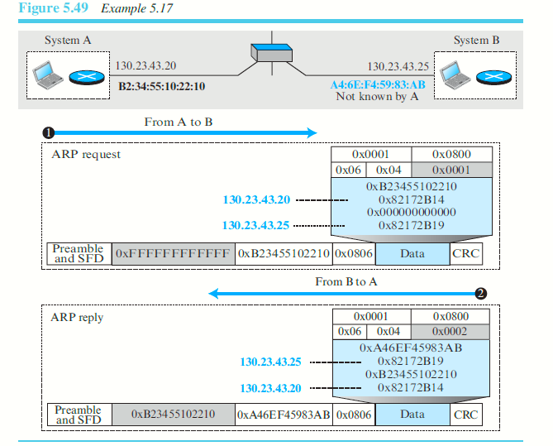
12.<number>

Slide 29
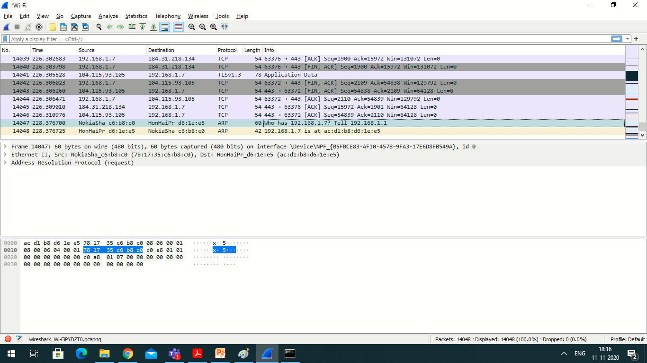
12.<number>

Slide 30
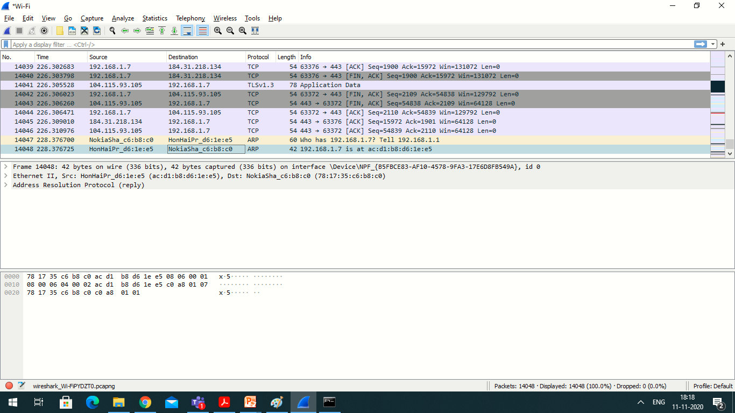
12.<number>

Slide 31
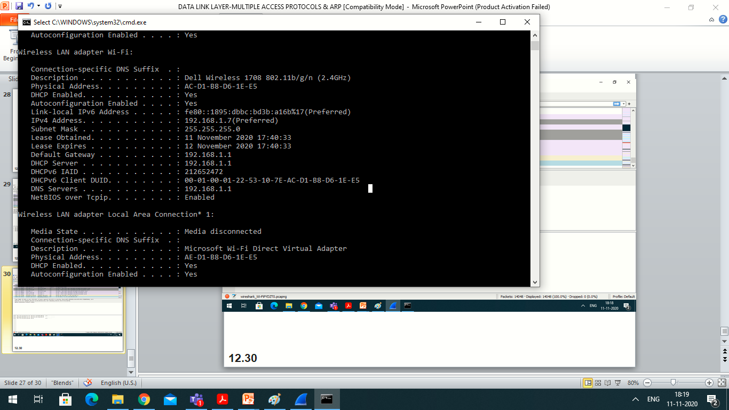
12.<number>

